Slide 1
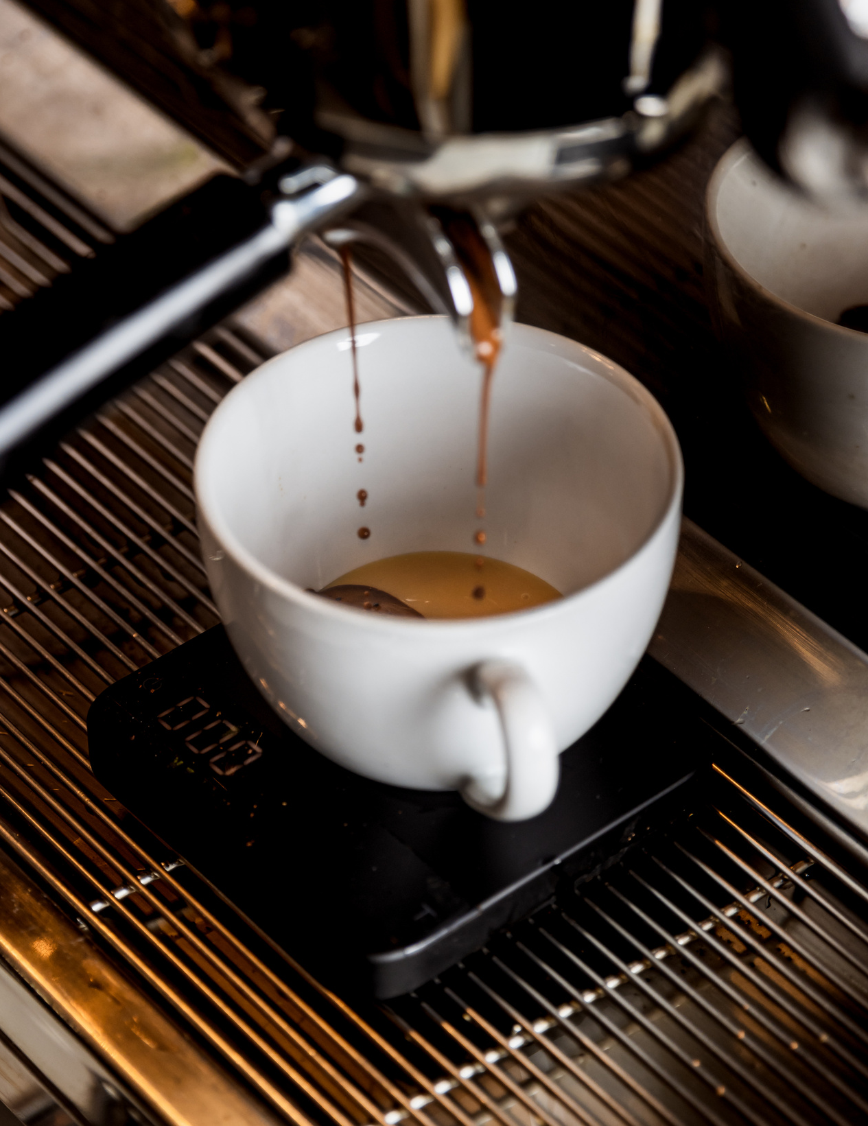
Starbucks Reward Redemption Proposal
MKT 566 Marketing Analytics
Presented by
Big Drip Marketing
March 10, 2022

Slide 2
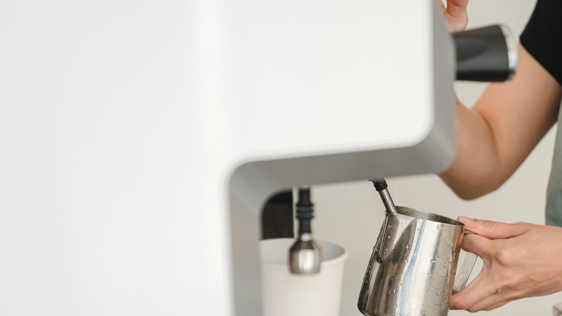
Background
The Starbucks Marketing Department is seeking to understand the customer characteristics associated with those that redeemed offers

Slide 3
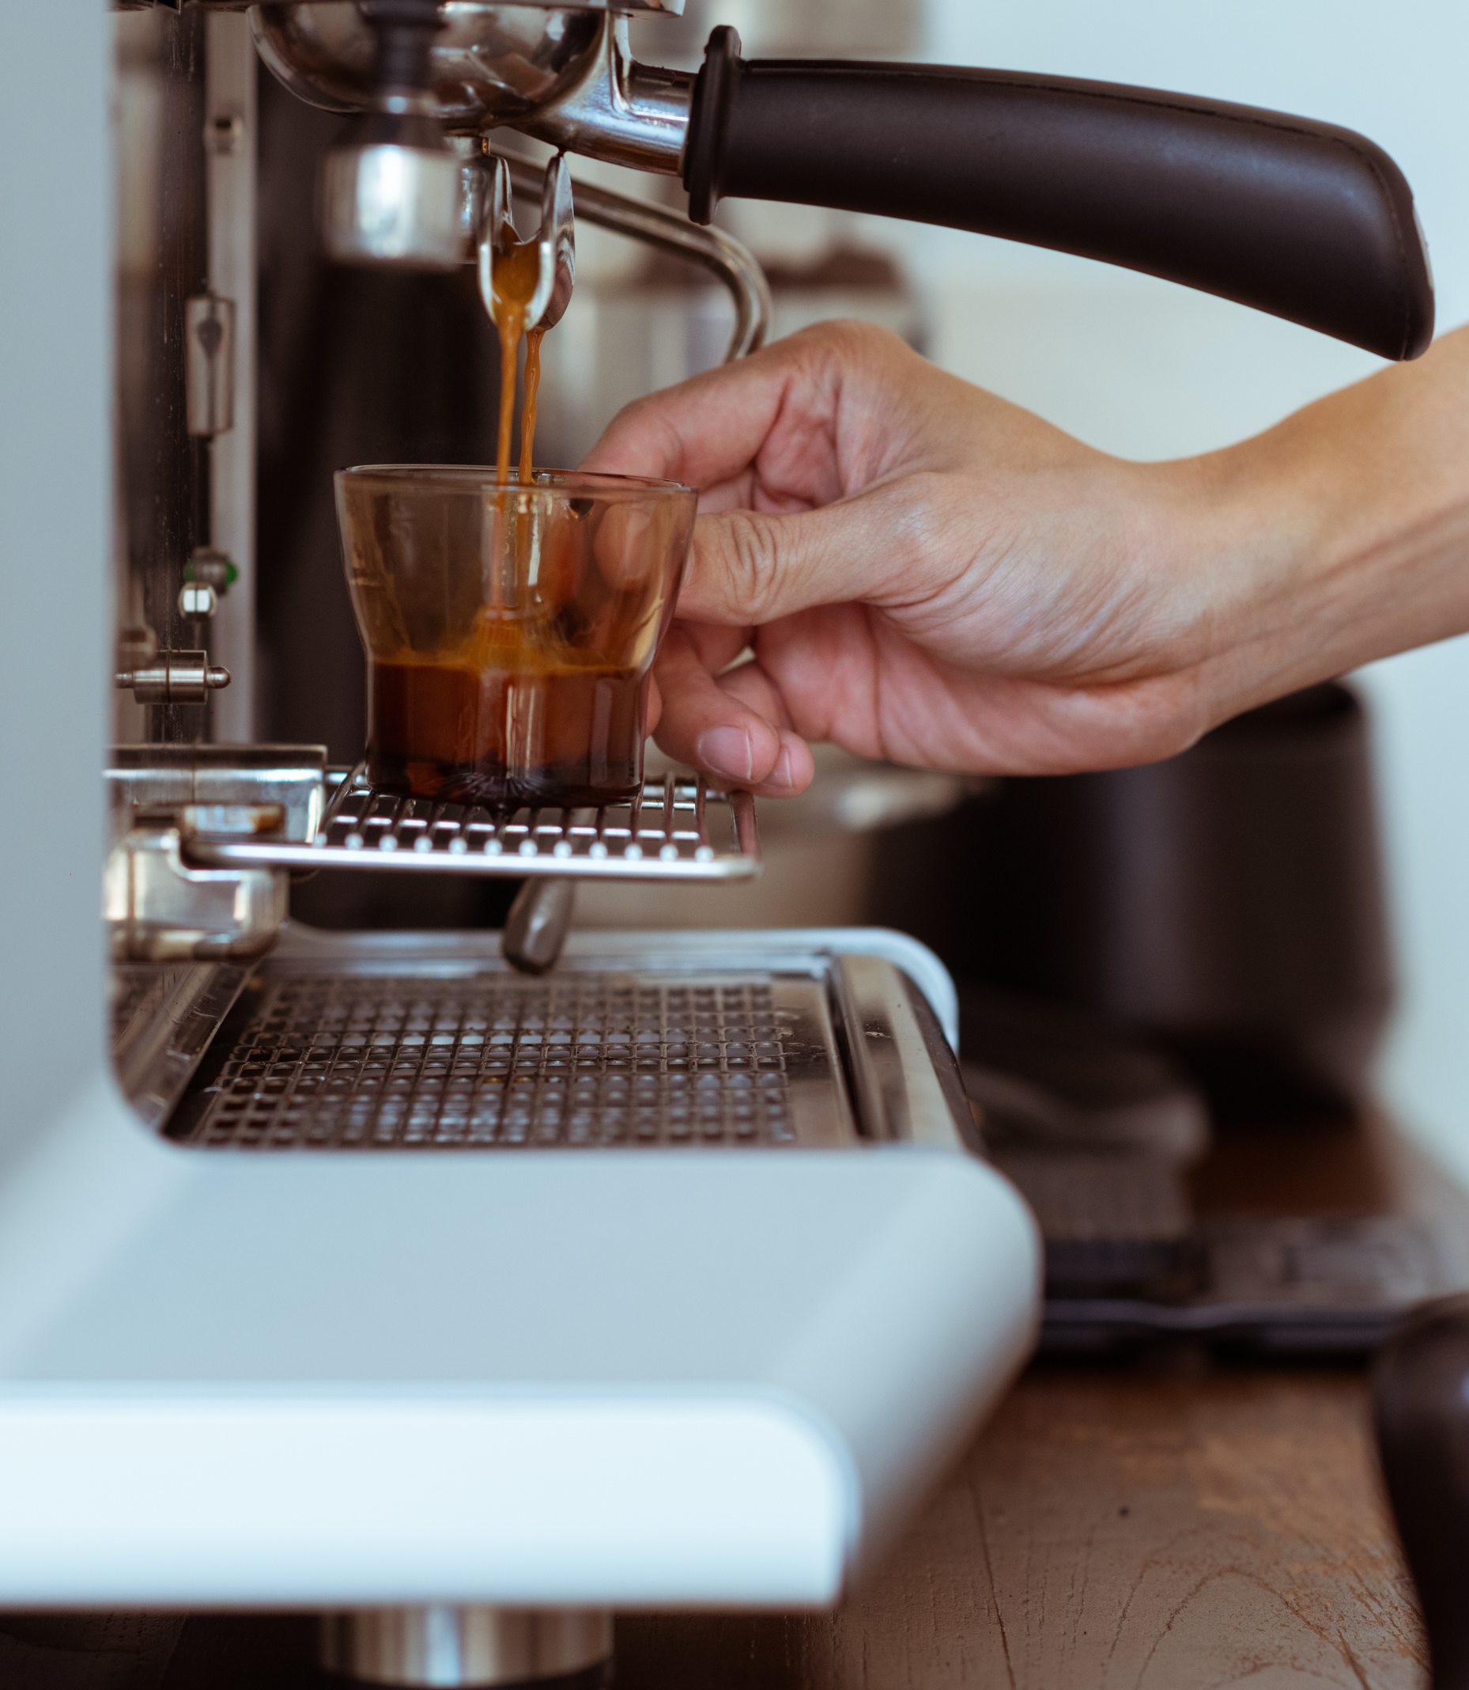
Outline
Marketing Question
Based on our clustering analysis, we are seeking to identify target markets segmented by demographic features and customer loyalty duration in an effort to build a marketing strategy that increases redeemed Starbucks offers.

Slide 4

Analysis
Approach
K-Means Clustering
Identify customer characteristics
& segment them
External Data Sources
Leverage outside market research to develop a recommendation for the Starbucks Marketing Department to increase offer redemptions & ROI on the offers

Slide 5
Data
source: https://www.kaggle.com/ishadss/coffee-starbucks-customer-clusters-and-eda
Profile
Information about customers such as Income, Age, Gender
Portfolio
Information about offers such as type, channels, duration
Transcript
Information about offer status such as received, completed, transaction
Data Challenges
Clean the data and remove unnecessary columns and null values; combine datasets & normalize the data

Slide 6



Anticipated
Managerial
Implications
& Challenges
Return on Coupon Code Spending
Strategize on how to best leverage the most effective offer types to reduce excess spending by the Starbucks' marketing team
Better Targeting
Starbucks managers can better understand the key characteristics that are associated with offer redemptions to improve store store sales and customer loyalty
Better Marketing Campaigns
Analysis results can be applied to create better marketing campaigns in the future to attract customers and build brands.

